Slide 1
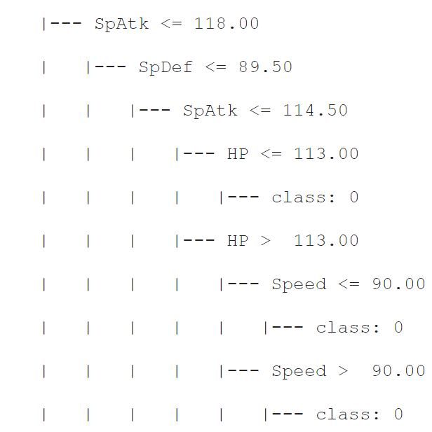
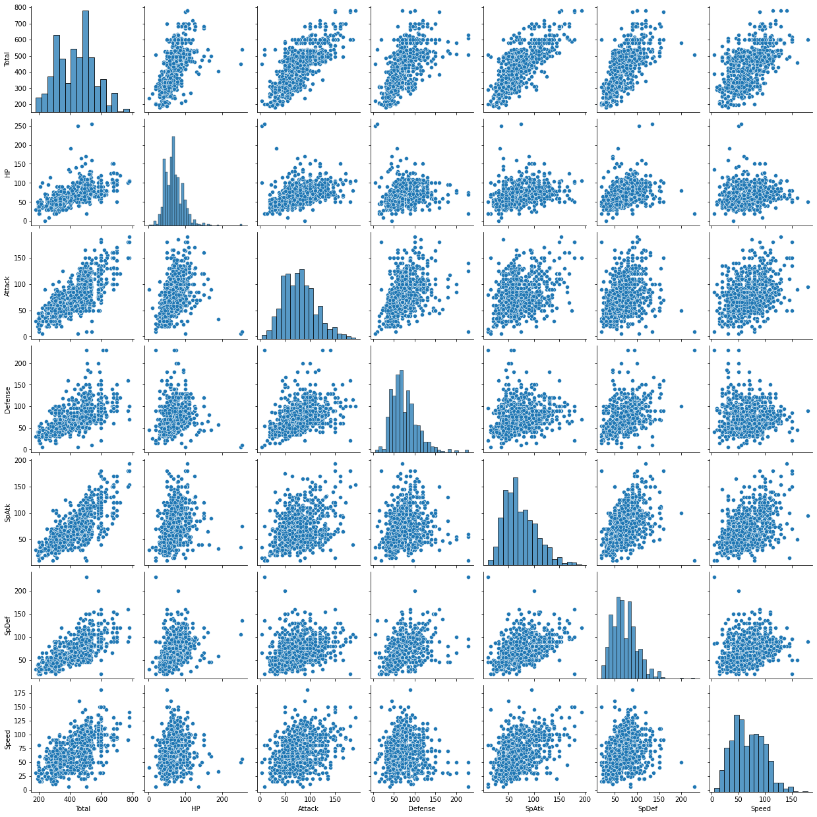
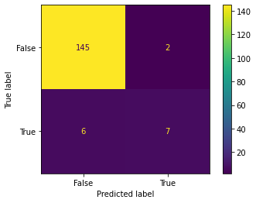



Title of Research Project
Authors and contributors
Background
Results
Pokémon is a popular game/animation around the world. The dataset contains specific statistics of about 800 Pokémons.
Accuracy: 95%
F1_Score(Predicted Performance Rate): 0.64
Research Questions
Conclusions
Supervised: Can we guess if the Pokémon is Legendary based on all the other Statistics?
s
Figure 1. Decision Tree
Using Decision Tree, though the Accuracy was high, the F1_Score was very low. This score may be improved using other supervised machine learning algorithm.
Methods
Features: ['HP','Attack','Defense','SpAtk','SpDef','Speed’]
Decision Tree
Acknowledgments
Thank those who provided guidance and support, including funding.
Figure 2. Pair Plot
Figure 3.Decision Tree Confusion Matrix
AI4ALL@Paul G. Allen School

